Slide 1
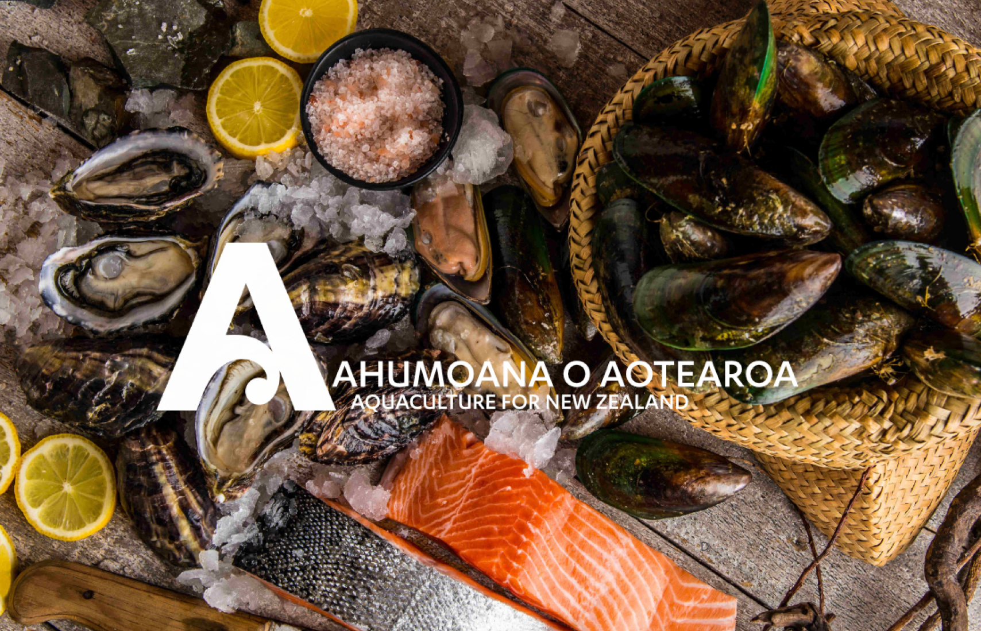
Notes:
Ahumoana o Aotearoa - Aquaculture for New Zealand.
Gary Hooper – Chief Executive, Aquaculture New Zealand
Aquaculture New Zealand (AQNZ) was formed in 2007 as a single voice for New Zealand's aquaculture industry, representing the interests of the three main species grown in New Zealand: Greenshell mussels, King salmon, and Pacific oysters. AQNZ’s purpose is to provide strategic direction and advocacy so the industry can continue, grow, innovate, add value, provide jobs, support communities and environmental care initiatives, and celebrate our sustainable and highly valued products.
Aquaculture production and processing directly employs over 3,000 people.
Many more people and businesses are involved in providing products and services to the sector.

Slide 2
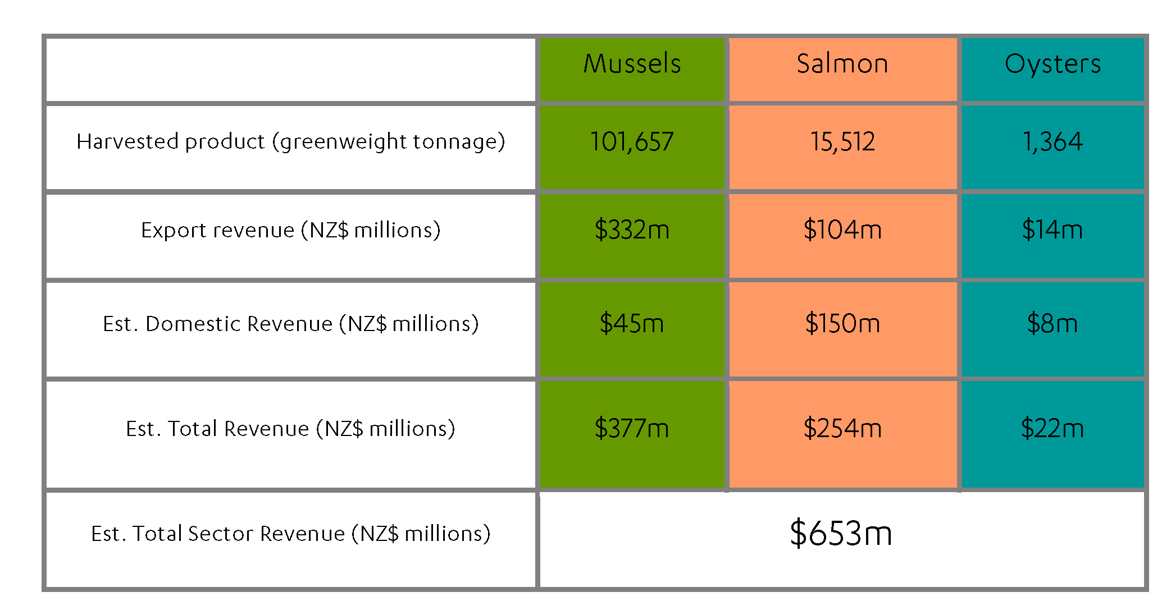
Figure 1. New Zealand aquaculture production and revenue for the 2020 calendar year.
Notes:
Shellfish, aquaculture in New Zealand has a strong export focus but uniquely salmon also is keenly supported by domestic consumption, so much so that supermarkets and other businesses are importing Atlantic salmon from Australia and Europe.
Current revenues circa $650 million but these have been dented by COVID-19 related restrictions-lock downs in key export markets.
We are now seeing strong recovery in both demand and price for our products.

Slide 3
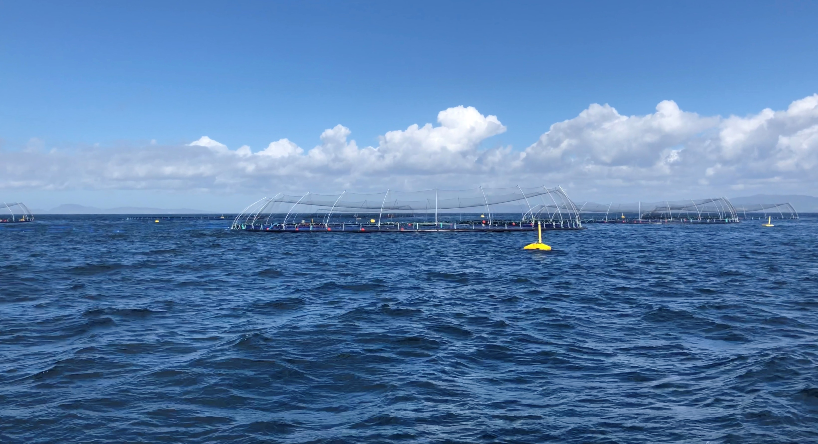
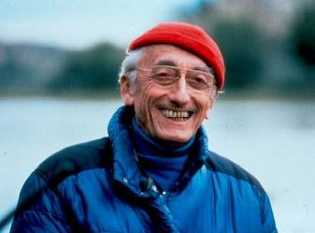
“We must turn to the sea with new understanding and new technology.
We need to farm it as we farm the land “
Jacques Cousteau, 1973
Notes:
3
“We must turn to the sea with new understanding and new technology. We need to farm it as we farm the land “
Jacques Cousteau, 1973
Already over half the world’s fish and seafood is sourced from aquaculture and this share will only grow with wild fishery catches largely static and seafoods acknowledged role in improving nutrition in modern diets.
We also need to be smart and continue to evolve our understanding and the best of available technologies so we don’t repeat sub optimal farming outcomes (terrestrial and aquaculture) from the past.

Slide 4
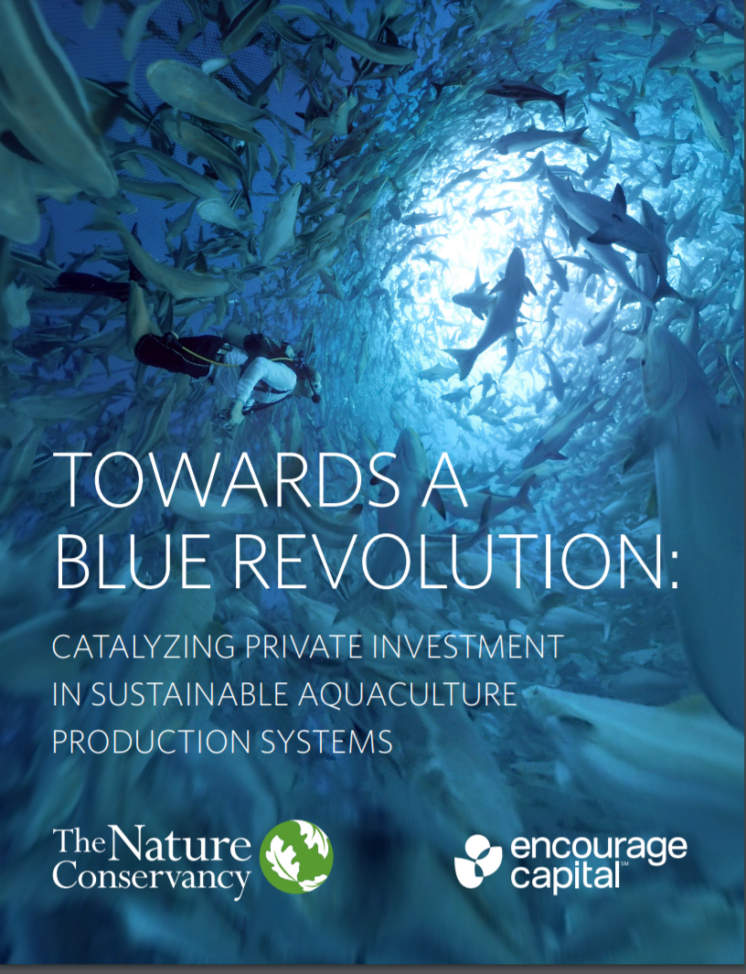
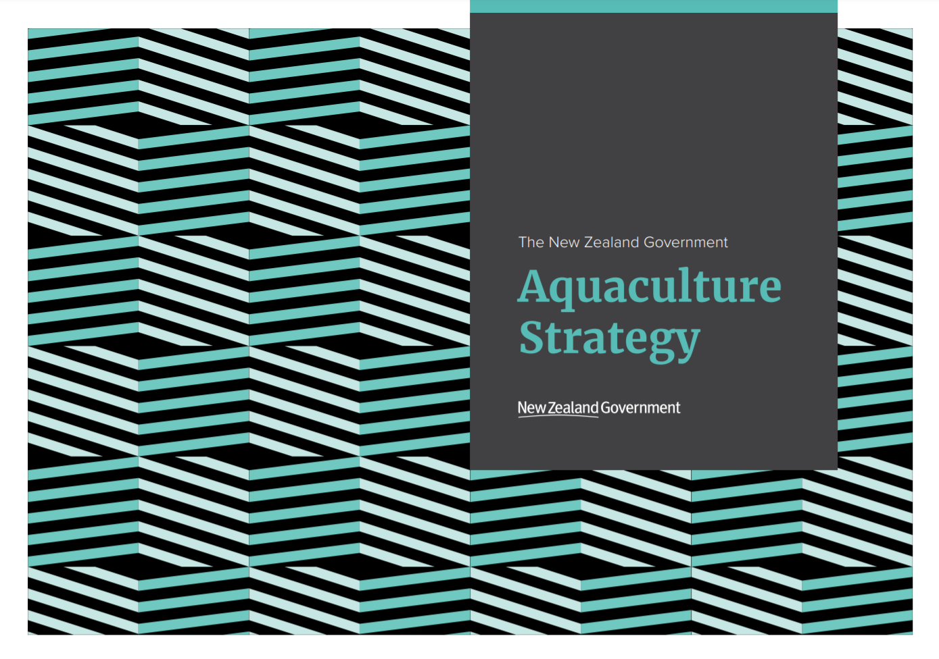
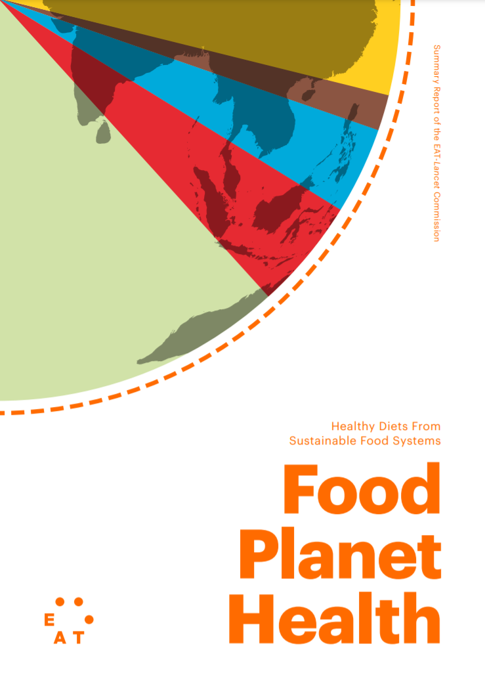
Notes:
Aquaculture - An opportunity for New Zealand?
Government Aquaculture Strategy – premised on values of being sustainable, productive, resilient and inclusive. Revenue aspiration of $3b by 2035.
Aquaculture is supported by respected international Environmental NGO’s
The Nature Conservancy - Aquaculture can be a key contributor to an environmentally and socially beneficial global food system, with the advantages of a lower environmental footprint than most meat production, limited use of land, and a sustainable source of healthy protein. TNC & Encourage Capital (2019). Towards a Blue Revolution: Catalyzing Private Capital in Sustainable Aquaculture Production Systems www.nature.org/content/dam/tnc/nature/en/documents/TNC_EncourageCapital_TowardsABlueRevolution_v1_1.pdf
Light environmental footprint – energy/freshwater use/limited impacts and virtually no irevesable effects
Efficient use of resources to generate Natural Nutritious products (cold blooded, not fighting gravity as per terrestrial animals)
Highly productive use of small amount of space.
High yield, high value and fully utilized (from Michelin stars to pampered pets)
Growing Domestic and International demand
Potential for significant economic growth = employment, export revenues, net economic benefits, social benefits and contribute to a low emission economy.
Post Covid recovery (Fit for a better world) the Government want to accelerate benefits from aquaculture in NZ $3 billion by 2030

Slide 5
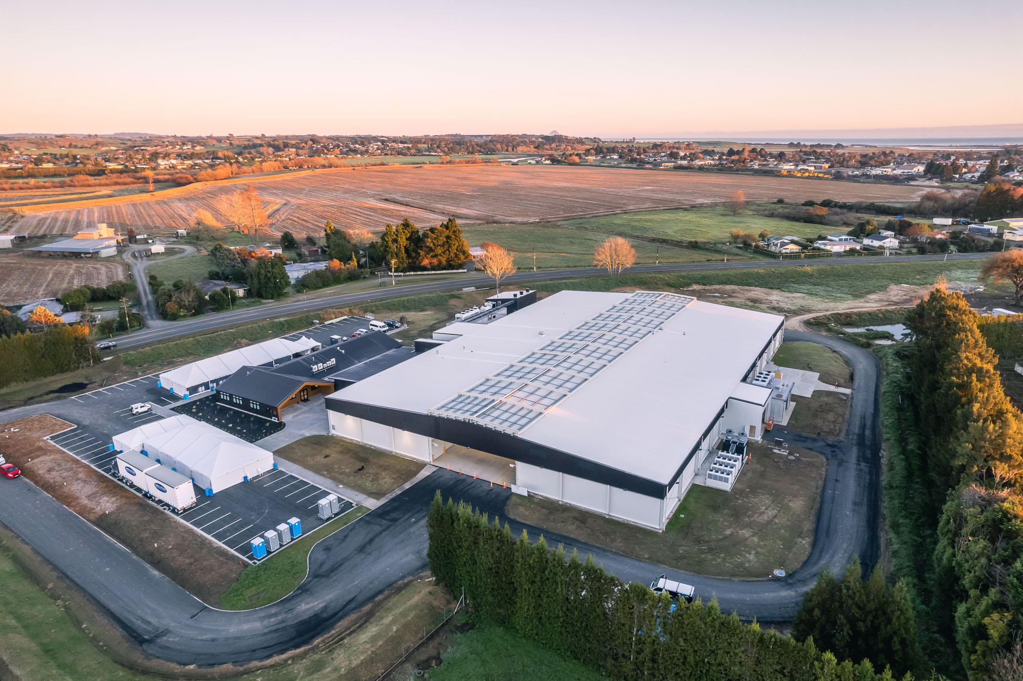
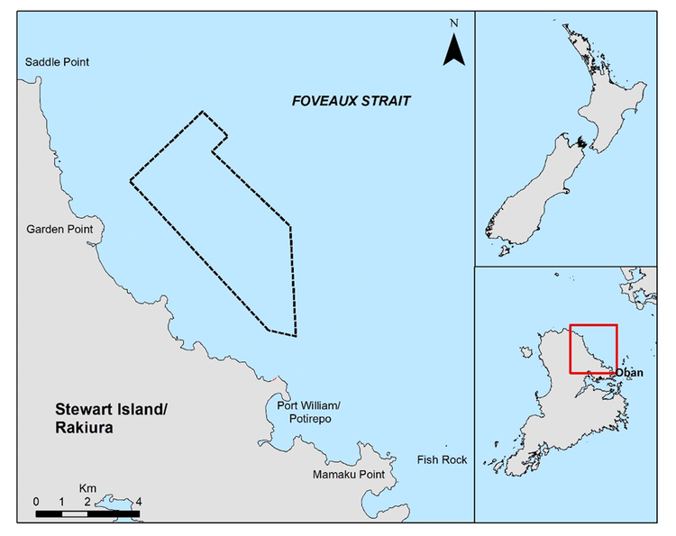
Aquaculture enables Rangatiratanga
mō tātou, ā, mō ka uri a muri ake nei
for us and our children after us
Notes:
Aquaculture enables Rangatiratanga
Whakatohea Trust Board – Open Ocean Mussels, and processing. Finfish and seaweed farming also possibilities
Ngai Tahu – Current application to farm salmon Foveaux Strait and recently aquaired 20% shareholding in listed seafood company Sanford.
We aspire to be a global leader in environmental best practice and build a lasting legacy that benefits our communities today and the future generations of tomorrow.
Ta Tipene O’Regan
“Ngāi Tahu want to be at the forefront of this sustainable and developing industry, as we undertake aquaculture projects which are aligned with our tribal values of rangatiratanga and kaitiakitanga, to help achieve the aspirations of our people,”
mō tātou, ā, mō ka uri a muri ake nei - for us and our children after us
Pare Hauraki – Mussel farming in the Firth of Thames has enabled community education and health services. Finfish also a possibility.
Māori Commercial Aquaculture Claims Settlement Act 2004 – 20% equivalence of new space

Slide 6
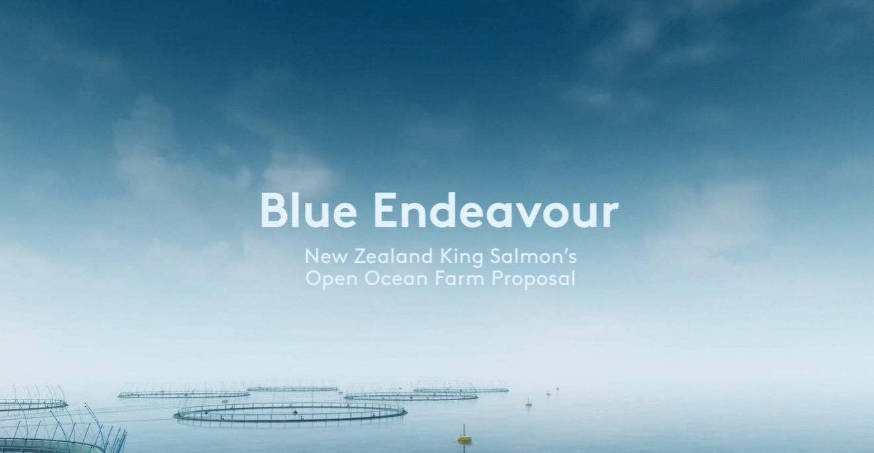
Notes:
A pioneering step into open ocean farming and a bold and bright future for Aquaculture in New Zealand and for the people of Te Tauihu
The Government’s Aquaculture Strategy notes:
‘Open ocean farming presents an opportunity to farm in cooler, deeper waters, and more easily position farms away from areas of high competing use. New Zealand’s exclusive economic zone is 15 times bigger than our land area – presenting significant potential.’
Salmon relocation discussions – collective interest in open ocean farming which at the time was hamstrung by available farming systems under development overseas.
Board of Inquiry/EPA sites – no sites were declined on ecological grounds and Appeals on such to the Supreme Court were dismissed
Blue Endeavour will provide greater certainty for farming salmon in Marlborough by providing increased resilience against climate change effects.

Slide 7
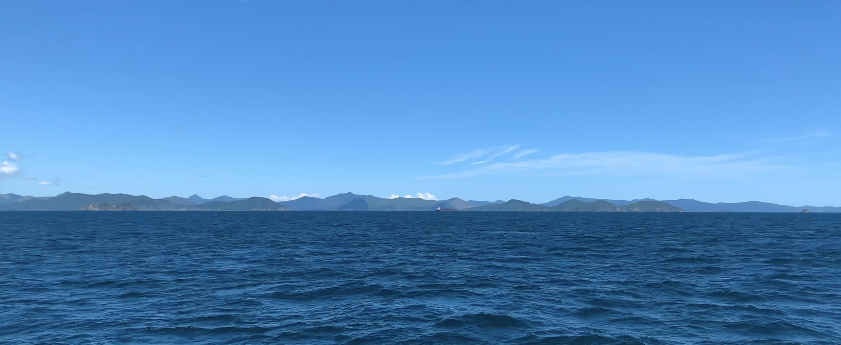
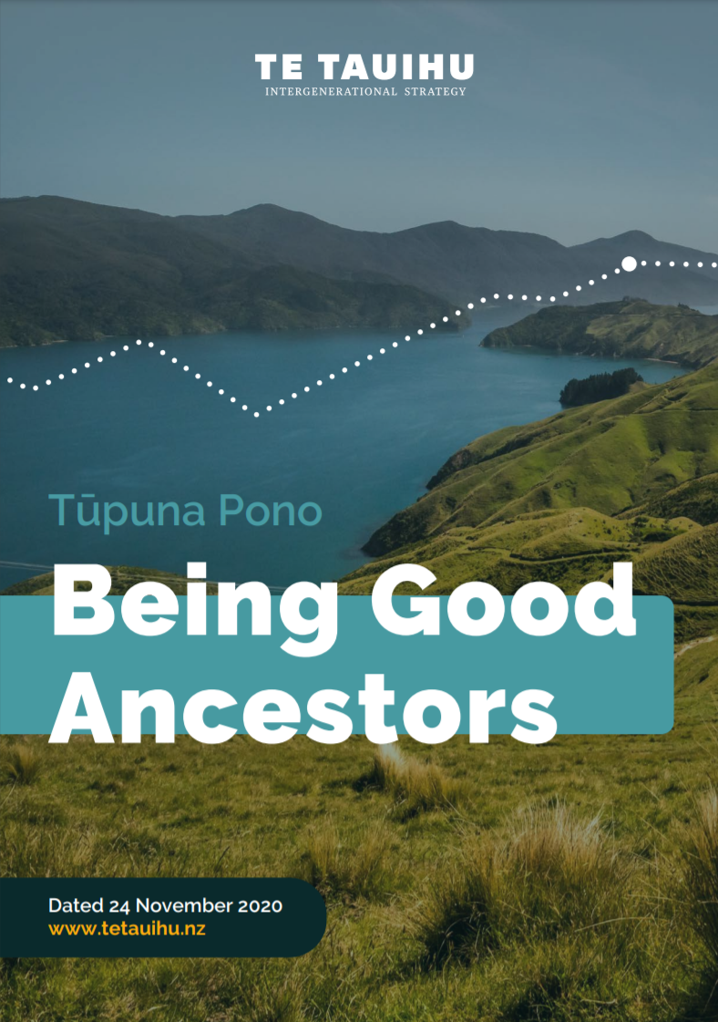
Opportunity for the people of Te Tauihu
Notes:
Opportunity for the people of Te Tauihu
Tupuna Pono – Being Good Ancestors is a ground-breaking collaborative inter-generational strategy for Te Tauihu
This strategy recognises the significance of our ocean economy and the importance of both inshore and open ocean aquaculture.
Project Kōkiri, the Nelson Tasman economic development collaboration set up to respond to and mitigate the economic impacts of the COVID-19 pandemic, also identifies the ocean economy as a regional strength, noting that 70% of New Zealand’s aquaculture is based in Te Tauihu and a priority opportunity to ‘grow a smarter economy’ is through (4.1) Accelerating Aquaculture
‘To accelerate the road to recovery, we need to act courageously and make the bold decisions required to tackle the challenges we face head on and instill a spirit of optimism and pride in the place that we call home. We need to build confidence in our region, stimulate the economy, bring people together and mitigate job losses and business closures.
Blue Endeavour will create
Economic and social stimulus into the region
Interesting jobs and careers
Increased automation and use of technology
Value from localised innovation and IP
Blue Endeavour will generate opportunity for Te Tauihu Iwi through Treaty settlement obligations.

Slide 8
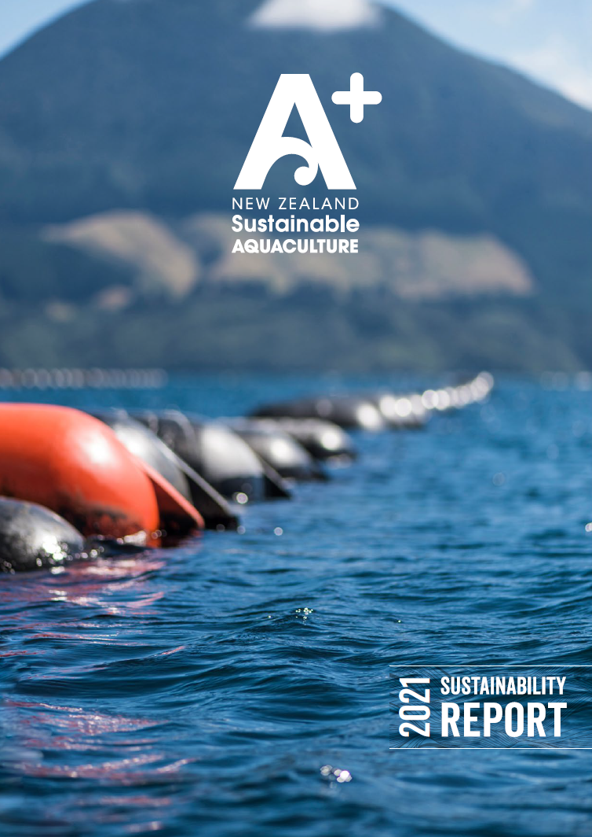
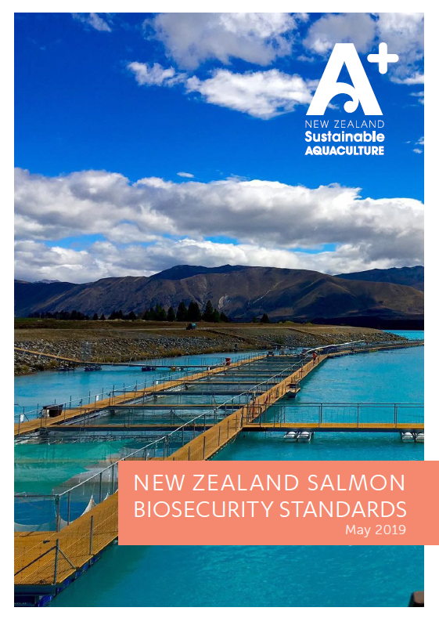
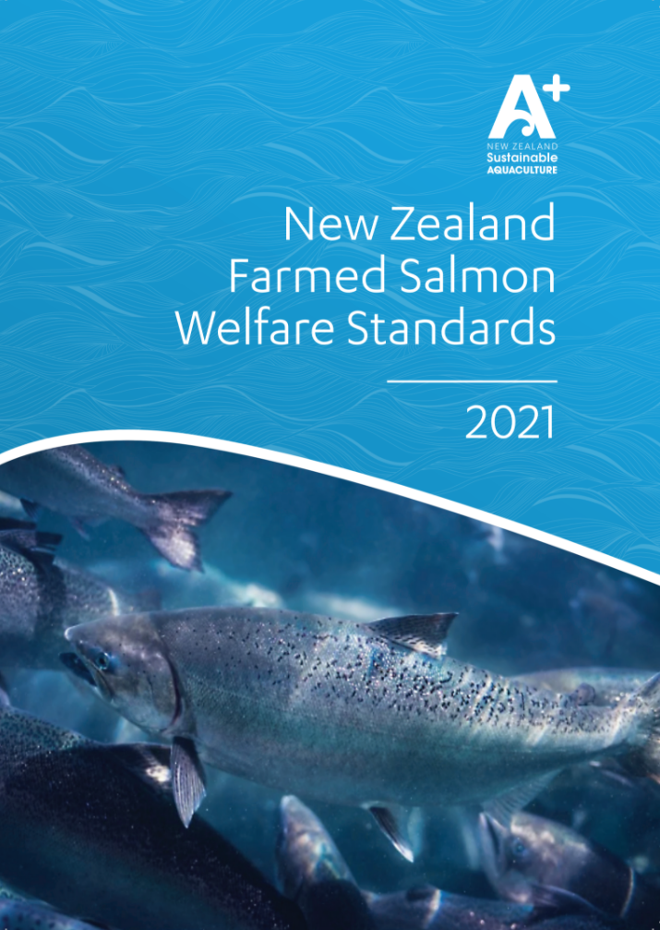
Notes:
The Aquaculture sector is committed to sustainability, and this is demonstrated though the A+ sustainability management programme where companies complete an annual checklist covering Ecology, Compliance, Biosecurity, Engagement with Iwi, Water Quality, Waste, Animal Health, Waste and Community.
This programme is externally audited and is increasingly recognised internationally for it’s comprehensive and practical approach.
The aquaculture sector is also at the forefront of marine biosecurity with detailed biosecurity standards. All salmon produces have biosecurity farm management plans.
We have also developed Farmed salmon animal welfare standards based on best international practices and we are working closely with the National Animal Welfare Advisory Committee on welfare for NZ farmed finfish.

Slide 9
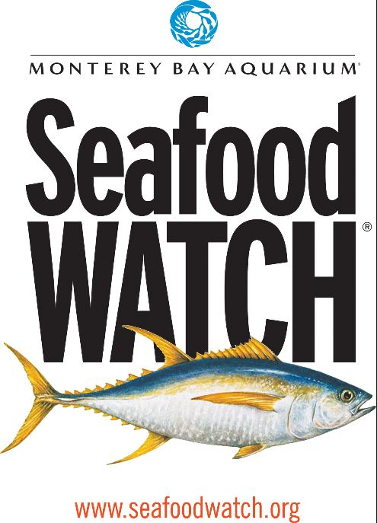
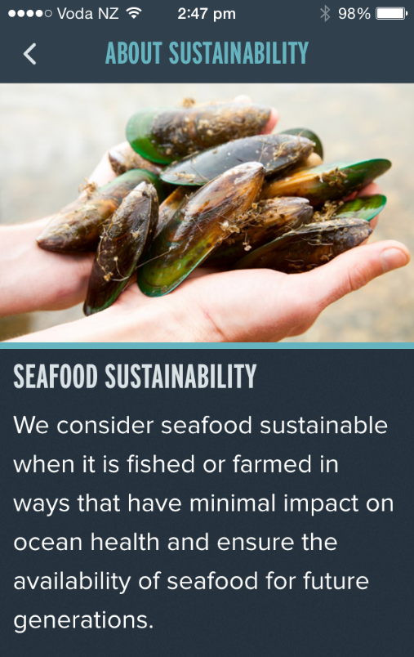
Notes:
Our sustainability practices and credentials are also recognised by global experts.
Monterey Bay Aquarium’s Seafood Watch is the most influential consumer seafood guide in North America.
New Zealand was the first and is still the only country where marine pen salmon aquaculture has the highest rating ‘best choice’ green rating.

Slide 10
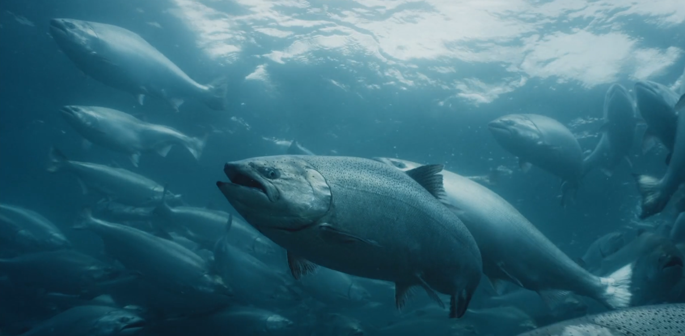
Unique species of salmon
Notes:
Unique species of salmon
King salmon – the King of salmon, aka Chinook or Quinnat (native of North West Coast of North America)
Feted by chefs and consumers world-wide
Accounts for less than 1% of the global farmed salmon which is dominated by Atlantic Salmon (Norway, UK, North America, Chile and Tasmanaia)
New Zealand is the largest producer of King salmon and has developed unique farming IP and breeding programmes.

Slide 11
Undisputed Leader in Taste…
Notes:
Undisputed Leader in Taste…
“[King Salmon] is generally considered the most delicious, and its name – the king salmon – is absolutely appropriate in more ways than one.” (Smithsonian.com)
“The best are king … which make amazing eating” (The New York Times)
“King Salmon … is top of the line in salmon, deep, rich colour and full flavour.” (Chefsref)
“I ran a taste test with my top staff, both kitchen and servers. Everyone agreed that the New Zealand King salmon was the best piece of salmon they had ever tasted by far,” said
Martin Rios, Restaurant Martin, Santa Fe.
“The oil content in the New Zealand King salmon changes the texture of the fish, and almost makes it incomparable since it is so different. It puts it in a different category and redefines what salmon can be,
” Mike Yakura, Ozuma, San Franciso.
.

Slide 12
Notes:
Back to Blue Endeavour.
A pioneering step into open ocean farming and a bold and bright future for Aquaculture in New Zealand and for the people of Te Tauihu
We congratulate The New Zealand King Salmon company for its comprehensive application and as importantly, for the way it has engaged with stakeholders and shared information along the way.

Slide 13
Notes:
Ahumoana o Aotearoa - Aquaculture for New Zealand.
Proudly, and possibly for the first time in our primary sector history, we’re considering a significant scale growth where environmental, cultural and social considerations are hard wired founding principles.
We need to be cautious and we need to be bold, but mostly we need to be smart and practical.
This is not a binary decision but rather a collective challenge to do the best we can in the spirit of Kaitiakitanga.
Aquaculture New Zealand support The New Zealand King Salmon Company’s (NZKS) resource consent application ‘Blue Endeavour’

